Slide 1

Google Play Store Apps Analysis
Shankar Mohanathas

Slide 2

Introduction
Objective
Data Source
Limitation

Slide 3
Question 1: What is the distribution of app categories in the Google Play Store?

Slide 4
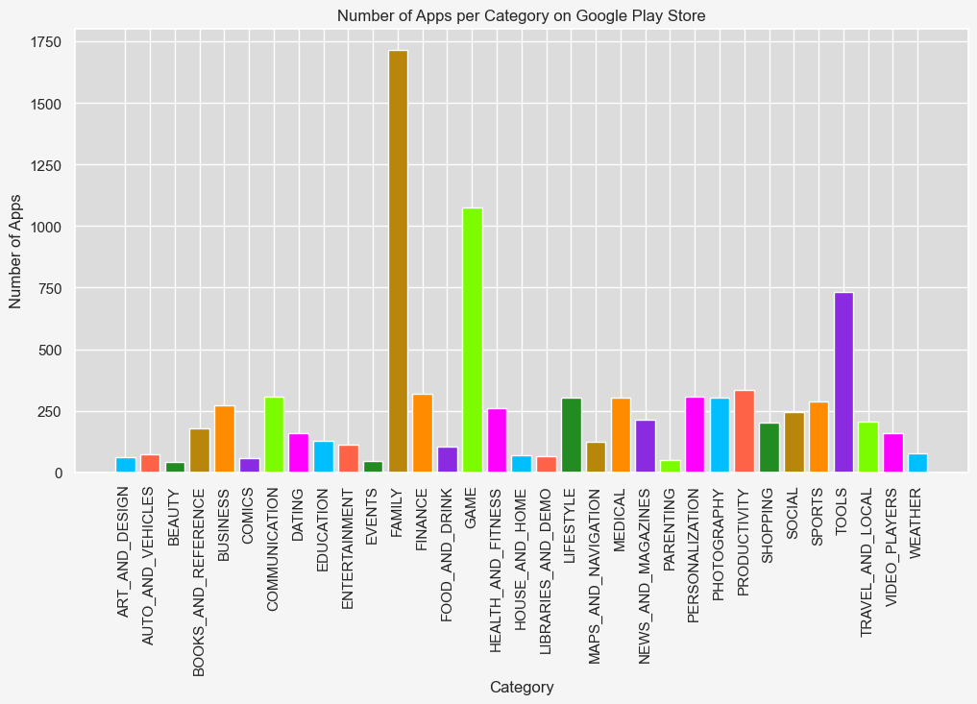
Top 3 Applications
Family
Game
Tools

Slide 5
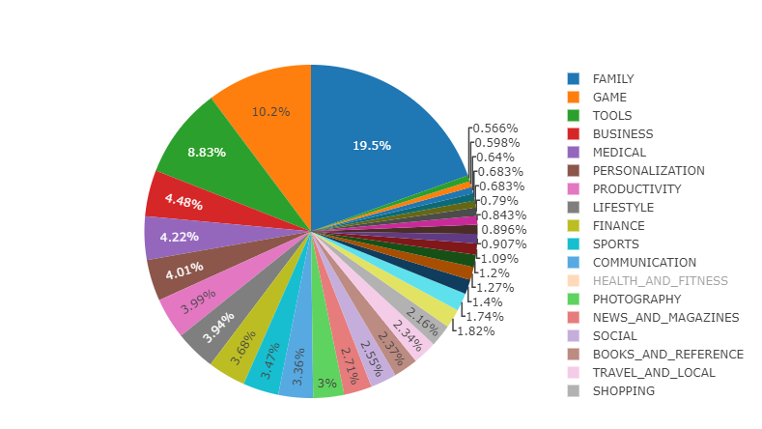

Slide 6
Question 2: What is the percentage of free vs paid apps, and does it affect the ratings in the Google Play Store?

Slide 7
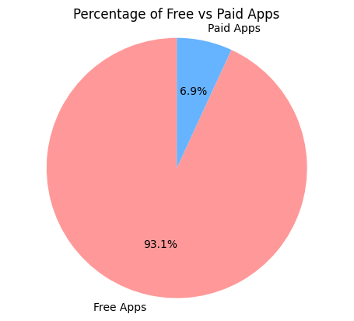
Interesting percentage breakdown of free apps vs paid apps.

Slide 8
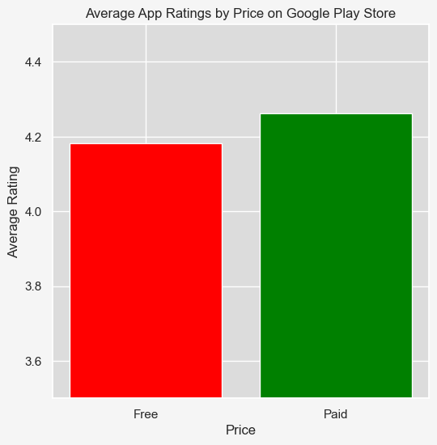

Slide 9
Question 3: What is the distribution of app ratings in the Google Play Store?

Slide 10
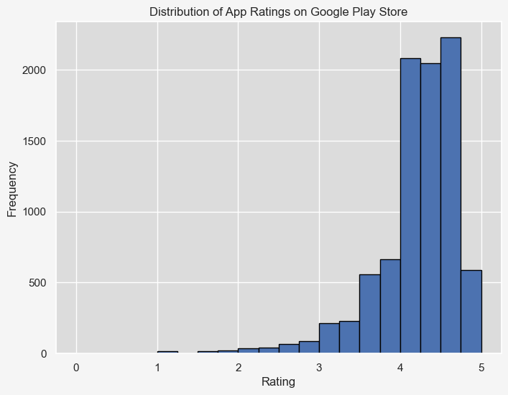
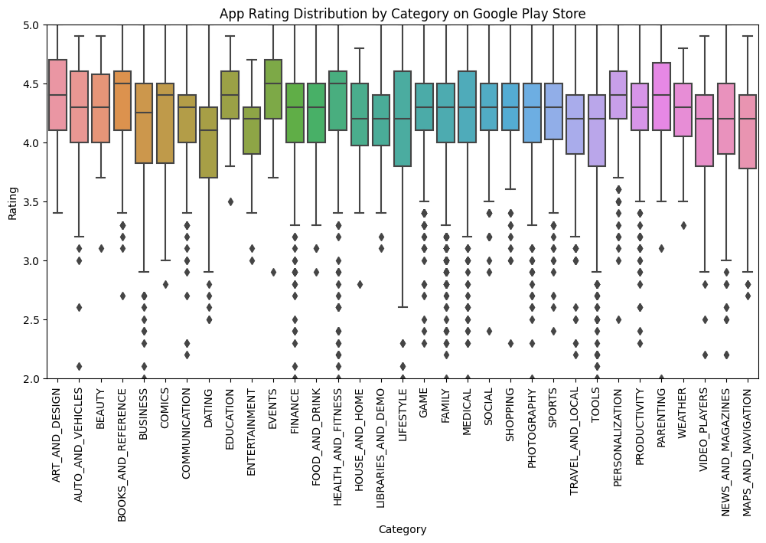
Distribution of Ratings

Slide 11

Question 4: How do the number of reviews correlate with app ratings?

Slide 12
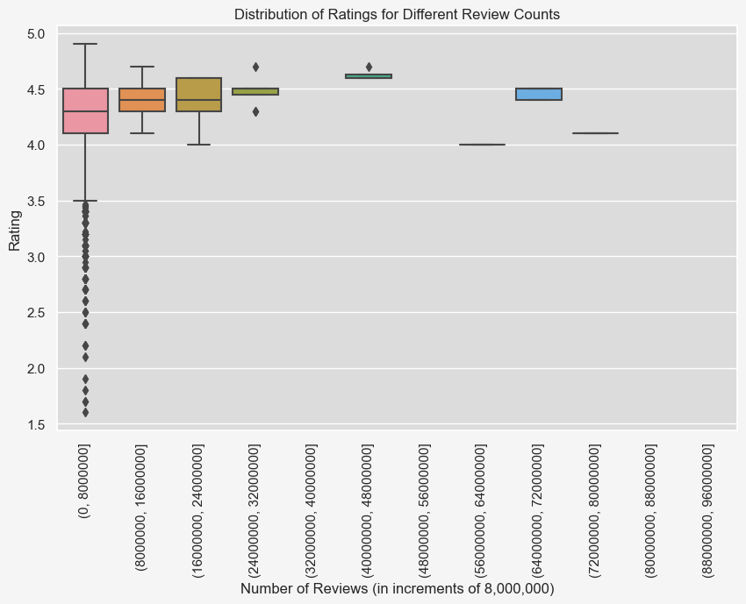
Comparing Reviews vs Rating for insight

Slide 13
Question 5: What are the most expensive app categories on the Google Play Store?

Slide 14
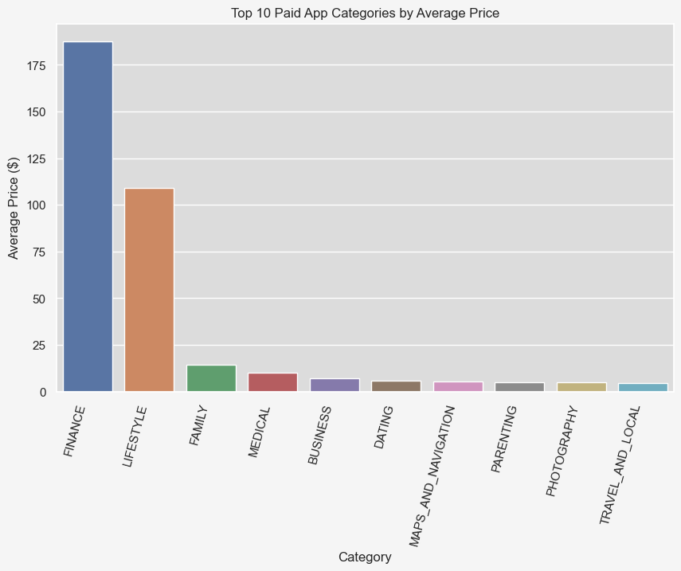
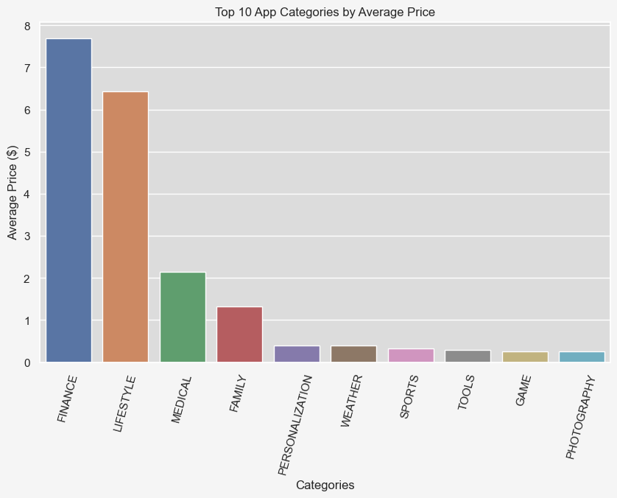
Comparison on Categories

Slide 15
Question 6: Which app categories have the highest number of installs?

Slide 16
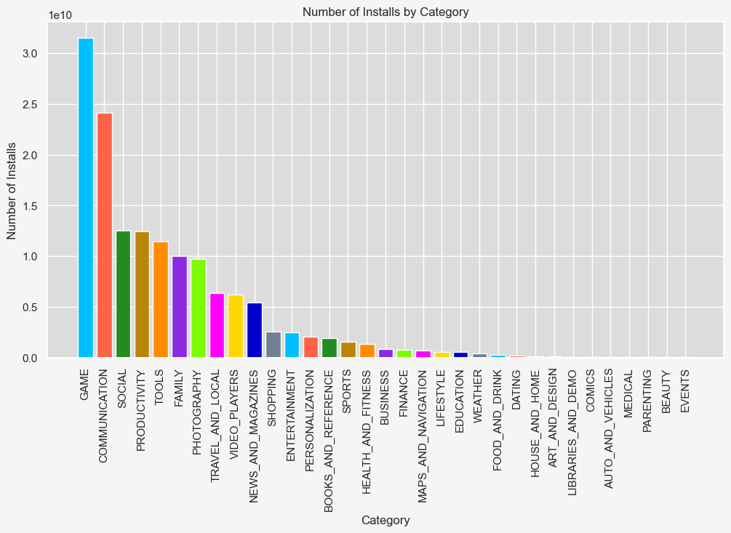
Top Installed App Categories
GAME
COMMUNICATION
SOCIAL

Slide 17

Question 7: How does app size affect the number of installs?

Slide 18
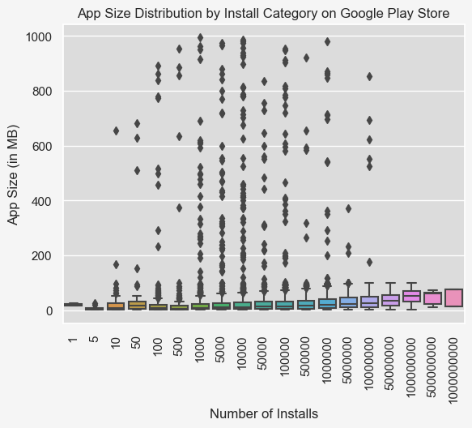
Comparions shows a weak correlation
Many outliers in the 1000-10 million installs range

Slide 19
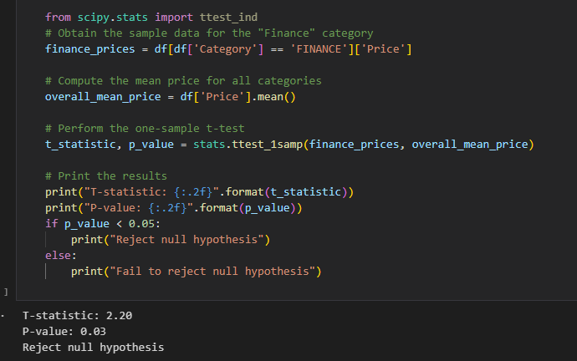
Statistical Analysis
This a one-sample t-test on the "Finance" category prices with the null hypothesis being that the average price of the "Finance" category is equal to the overall average price of all categories.
If the p-value is less than the significance level of 0.05, we reject the null hypothesis and conclude that the average price of the "Finance" category is significantly different from the overall average price of all categories.

Slide 20

Analysis & Findings

Slide 21

Questions?

